Slide 1


ACCS16301
COALP
Unit – 12
Memory Organization
Er. Pavitar Singh
(Assistant Professor)
pavitar.cse@acetedu.in

Slide 2
Topics to be covered
Memory Hierarchy
Main Memory
Associative Memory
Cache Memory
Virtual Memory

Slide 3
12-1 Memory Hierarchy
Computer System use storage devices to store the bulk of information needed in digital computation as well as for saving the information for future reference.
Primary Storage.
Secondary & Offline Storage.
Primary Storage :-
-> Directly connected with CPU.
-> No use of computer’s input/output channels.
-> Used to store data that is likely to be in active use.
-> Very Fast.
-> Examples : Processor Registers, Cache Memory & Main Memory
Two Types :
Volatile – Cache ,Processor Registers, RAM
Non-Volatile – ROM

Slide 4
Secondary Memory :-
Auxiliary or External or Mass Storage.
Non-Volatile Memory with huge capacities.
Use of Input/output Channels to access the information.
Greater capacity than Primary but Slower.
Examples: Magnetic Tapes, Hard Disk,Floppy Disk ,CDs ,DVDs.
Offline Memory :-
Type of secondary storage where medium can be easily removed.
Used for data transfer & Archival Purposes.
Examples :-USB drives, Memory Cards, Memory Sticks, USB Hard disk.

Slide 5
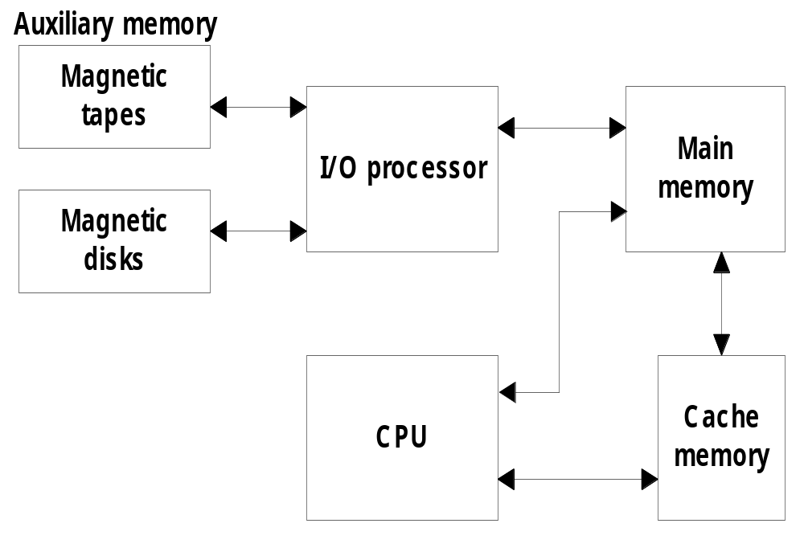
Memory hierarchy in a computer system
    Main Memory : memory unit that communicates directly with the CPU (RAM)
    Auxiliary Memory : device that provide backup storage (Disk Drives)
    Cache Memory : special very-high-speed memory to increase the processing speed. Small Memory used for storage of most frequent programs.

Slide 6
Why we have 2 or 3 levels of Memory Hierarchy ?(Imp)
As the storage capacity of memory increases the cost/bit for storing info decreases & the access time becomes longer
Cost Inc.
Capacity Dec. Cost Dec.
Capacity Inc.
Capacity is inversely Prop to Cost.
Access Time Ratio :- 1 : 7 : 1000
Register
Cache
Main Memory
Auxiliary Memory

Slide 7
MAIN MEMORY
Bootstrap Loader:- (stored in ROM)
    A program whose function is to start the computer software operating when power is turned on.
Main Memory
RAM ROM
EEPROM
Dynamic Static PROM EAROM
EPROM

Slide 8
Types of Primary Memory
RAM
ROM
Random Access Memory
Volatile Memory.
Read/Write Memory.
Used for storing the bulk of programs & data that are subject to change.
Replaced easily.
Used for storing User’s data.
Bidirectional Bus.
Read Only Memory
Non-volatile Memory.
Only Read ,No write.
Used for storing program that permanently resides in computer system.
Motherboard replaced.
Used for system’s program.
Unidirectional Bus.

Slide 9
Associative Memory

Slide 10
Associative Memory (Content Addressable Memory)
The time required to find an item stored in memory can be reduced considerably if stored data can be identified for access by the content of the data itself rather than by an address.
A memory unit accessed by content is called an associative memory or content addressable memory (CAM).
This type of memory is accessed simultaneously and in parallel on the basis of data content rather than by specific address or location.

Slide 11
Associative Memory
Argument register (A)
A
101 111100
Argument
K
111 000000
Key (Mask)
100 111100
W1
100 111100
No match
Match Logic
Key register (K)
W2
101 000001
101 000001
Match
Match
register
Associative memory
array and logic
m words
n bits per word
M
Input
Read
Write
Output

Slide 12
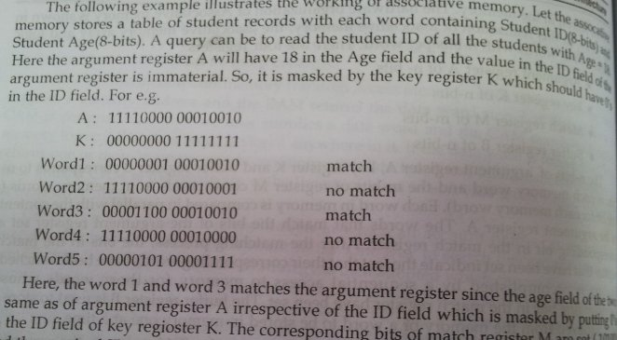


Slide 13
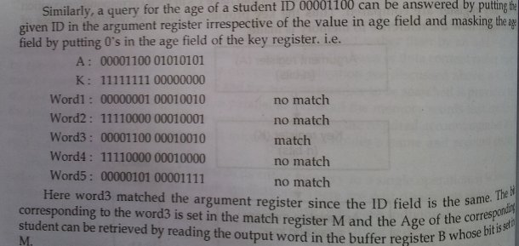

Slide 14
Cache Memory

Slide 15
Cache Memory
  Cache Memory : a fast small memory
    keeping the most frequently accessed instructions and data in the fast cache memory
    If the word is found in the cache, it is read from the fast memory. If the word addressed by the CPU is not found in the cache, the main memory is accessed to read the word.

Slide 16
  Replacement Algorithm :
    1) LRU (Least Recently Used) :
    2) LFU (Least Frequently Used) :
    3) FIFO (First-In First-Out) :
    Write policy : 1) write-through, 2) write-back
  Hit Ratio The performance of the cache memory is frequently measured in terms of a quantity called hit ratio.
    the ratio of the number of hits divided by the total CPU references
    (hits + misses) to memory
      hit : the CPU finds the word in the cache.
      Hit ratios of 0.9 and higher have been reported.
      miss : the word is not found in cache (CPU must read main memory)

Slide 17
Locality of reference
  Locality of Reference
    the references to memory tend to be confined within a few localized areas in memory
Principle of Locality:
Temporal locality:
Recently referenced items are likely to be referenced in the near future.
(If a word is referenced now then the same word will be referenced again.) (LRU is used)
Example- Reference sum each iteration.
Spatial locality: Items with nearby addresses tend to be referenced close together in time. (If a word is accessed now then the word adjacent to it will be accessed next.)
Example- Reference array elements in succession.
sum = 0;
for (i = 0; i < n; i++)
sum += a[i];
return sum;

Slide 18
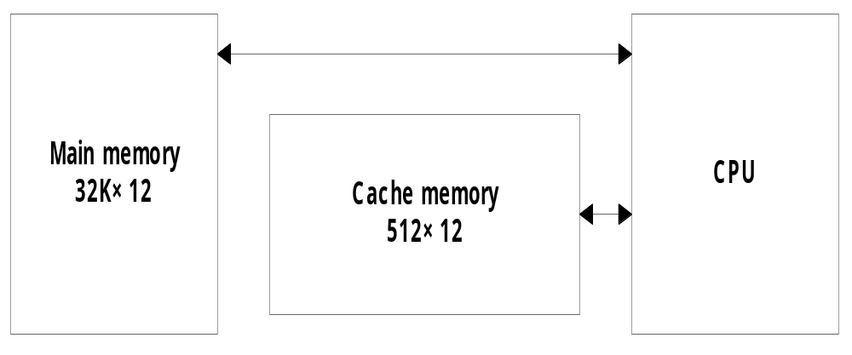
  Mapping
    The transformation of data from main memory to cache memory
      1) Associative mapping
      2) Direct mapping
      3) Set-associative mapping
  Example of cache memory :
    main memory : 32 K x 12 bit word (15 bit address lines)
    cache memory : 512 x 12 bit word
      CPU sends a 15-bit address to cache
        Hit : CPU accepts the 12-bit data from cache
        Miss : CPU reads the data from main memory

Slide 19
Associative Mapping
CPU address (15 bits)
Argument register
Address
Data
0 1 0 0 0
3 4 5 0
0 2 7 7 7
6 7 1 0
2 2 3 4 5
1 2 3 4

Slide 20
Direct Mapping
6 bits
9 bits
Tag
Index
00
000
32K X 12
Main memory
Address = 15 bits
Data = 12 bits
000
512 X 12
Cache memory
Address = 9 bits
Data = 12 bits
Octal
address
Octal
address
77
777
777

Slide 21
Direct Mapping
Memory address
Index address
Memory data
Tag
Data
00000
1 2 2 0
000
0 0
1 2 2 0
00777
2 3 4 0
01000
3 4 5 0
01777
4 5 6 0
777
0 2
6 7 1 0
02000
5 6 7 0
Cache Memory
02777
6 7 1 0
Main Memory

Slide 22
Disadvantage of direct mapping
Hit Ratio can drop considerably if two or more words whose addresses have the same index but different tags are accessed repeatedly.
This possibility is minimized by the fact that such words are relatively far apart in the address range.
Two words with same index in their address but different tag values cannot reside in cache memory at the same time.

Slide 23
Set-Associative Mapping
Index
Tag
Data
Tag
Data
000
0 1
3 4 5 0
0 2
5 6 7 0
777
0 2
6 7 1 0
0 0
2 3 4 0

